Slide 1
BLOCKCHAIN
SMP July ‘21

Slide 2
CONTENTS
Blockchain Fundamentals
Why was Blockchain created?
The birth of Bitcoin
Voila! Blockchain
How is Blockchain better than traditional Business Network?
Why trust Blockchain?

Slide 3
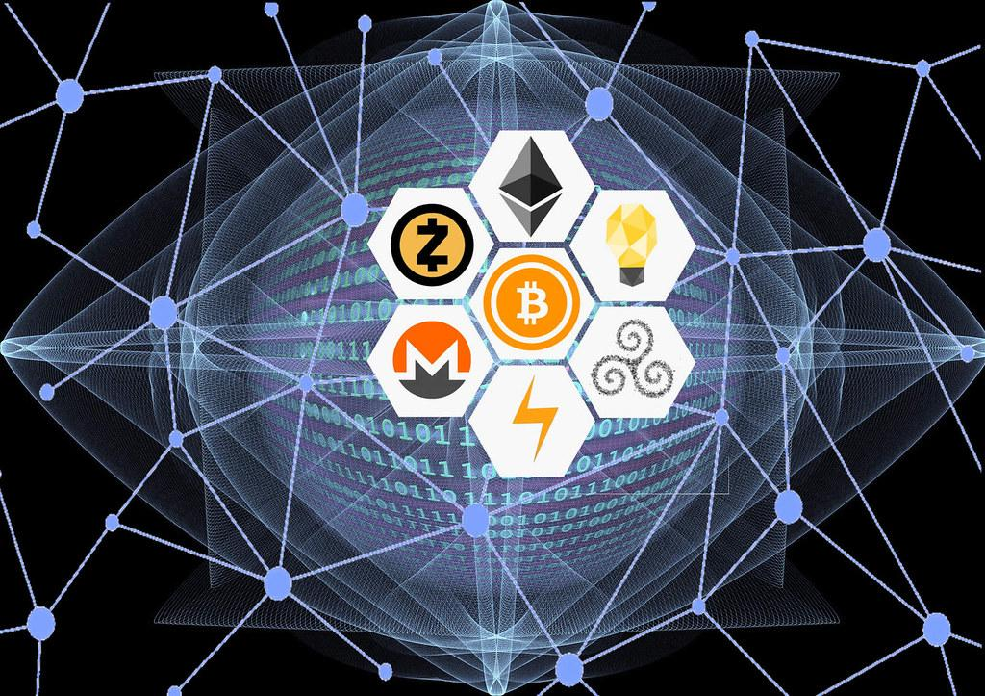
Blockchain Fundamentals
Blockchain is a shared, distributed ledger that facilitates the process of recording transactions and tracking assets in a business network. An asset can be tangible — a house, a car, cash, land — or intangible like intellectual property, such as patents, copyrights, or branding. Virtually anything of value can be tracked and traded on a blockchain network, reducing risk and cutting costs for all involved.

Slide 4
Why was Blockchain created?
Throughout history, instruments of trust, such as minted coins, paper money, letters of credit, and banking systems, have emerged to facilitate the exchange of value and protect buyers and sellers. Important innovations, including telephone lines, credit card systems, the Internet, and mobile technologies have improved the convenience, speed, and efficiency of transactions while shrinking and sometimes virtually eliminating the distance between buyers and sellers. Still, many business transactions remain inefficient, expensive, and vulnerable.

Slide 5
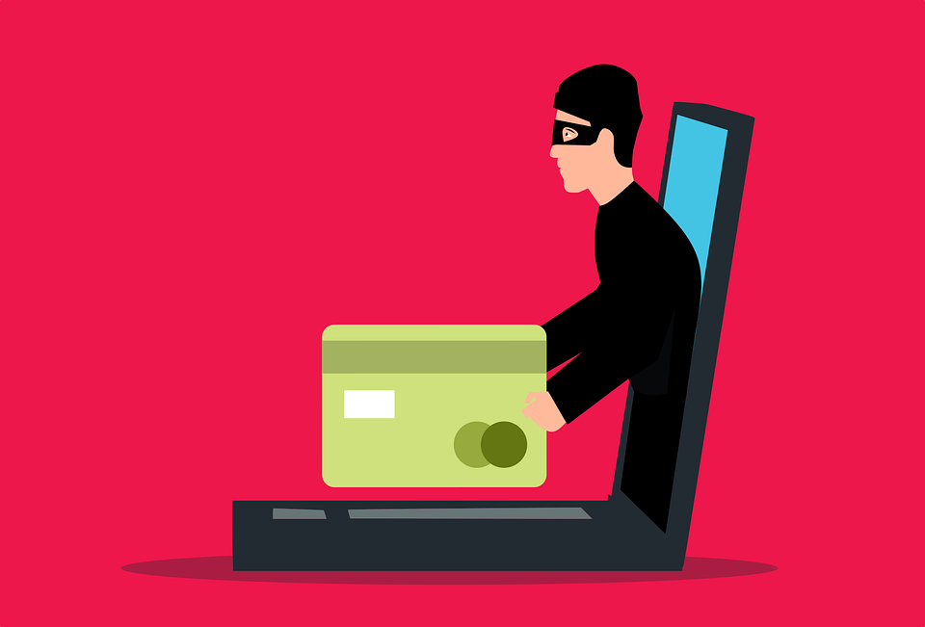
Limitations of Traditional methods of Transactions
Cash is useful only in local transactions and in relatively small amounts.
The time between transaction and settlement can be long.
Duplication of effort and the need for third-party validation and/or the presence of intermediaries add to the inefficiencies.
Fraud, cyberattacks, and even simple mistakes add to the cost and complexity of doing business, and they expose all participants in the network to risk if a central system, such as a bank, is compromised.
Credit card organizations have essentially created walled gardens with a high price of entry. Merchants must pay the high costs of onboarding, which often involves considerable paperwork and a time-consuming vetting process.
Half of the people in the world don’t have access to a bank account and have had to develop parallel payment systems to conduct transaction

Slide 6

The birth of Bitcoin
One solution that has been developed to address the complexities, vulnerabilities, inefficiencies, and costs of current transaction systems is bitcoin — a digital currency that was launched in 2009 by a mysterious person (or persons) known only by the pseudonym Satoshi Nakamoto.
Unlike traditional currencies, which are issued by central banks, bitcoin has no central monetary authority. No one controls it.
Bitcoins aren’t printed like dollars or euros; they’re “mined” by people and increasingly by businesses, running computers all around the world, using software that solves mathematical puzzles.
Rather than rely on a central monetary authority to monitor, verify, and approve transactions and manage the money supply, bitcoin is enabled by a peer-to-peer computer network made up of its users’ machines, akin to the networks that underpin BitTorrent and Skype

Slide 7
Voila! Blockchain
Bitcoin is actually built on the foundation of blockchain, which serves as bitcoin’s shared ledger. Think of blockchain as an operating system, such as Microsoft Windows or MacOS, and bitcoin as only one of the many applications that can be run on that operating system.
Blockchain provides the means for recording bitcoin transactions — the shared ledger — but this shared ledger can be used to record any transaction and track the movement of any asset whether tangible, intangible, or digital. For example, blockchain enables securities to be settled in minutes instead of days.
It can also be used to help companies manage the flow of goods and related payments, or enable manufacturers to share production logs with original equipment manufacturers (OEMs) and regulators to reduce product recalls.
The takeaway lesson: Bitcoin and blockchain are not the same. Blockchain provides the means to record and store bitcoin transactions, but blockchain has many uses beyond bitcoin. Bitcoin is only the first use case for blockchain.

Slide 8
How is Blockchain better than traditional Business Network?
A blockchain network has the following key characteristics:
Consensus: For a transaction to be valid, all participants must agree on its validity.
Provenance: Participants know where the asset came from and how its ownership has changed over time.
Immutability: No participant can tamper with a transaction after it’s been recorded to the ledger. If a transaction is in error, a new transaction must be used to reverse the error, and both transactions are then visible.
Finality: A single, shared ledger provides one place to go to determine the ownership of an asset or the completion of a transaction.

Slide 9
Why Trust Blockchain?
Blockchain builds trust through the following five attributes:
Distributed and sustainable: The ledger is shared, updated with every transaction, and selectively replicated among participants in near real time. Because it’s not owned or controlled by any single organization, the blockchain platform’s continued existence isn’t dependent on any individual entity.
Secure, private, and indelible: Permissions and cryptography prevent unauthorized access to the network and ensure that participants are who they claim to be. Privacy is maintained through cryptographic techniques and/or data partitioning techniques to give participants selective visibility into the ledger; both transactions and the identity of transacting parties can be masked. After conditions are agreed to, participants can’t tamper with a record of the transaction; errors can be reversed only with new transactions.

Slide 10
Transparent and auditable: Because participants in a transaction have access to the same records, they can validate transactions and verify identities or ownership without the need for third-party intermediaries. Transactions are time-stamped and can be verified in near real time.
Consensus-based and transactional: All relevant network participants must agree that a transaction is valid. This is achieved through the use of consensus algorithms. Each blockchain network can establish the conditions under which a transaction or asset exchange can occur.
Orchestrated and flexible: Because business rules and smart contracts (that execute based on one or more conditions) can be built into the platform, blockchain business networks can evolve as they mature to support end-to-end business processes and a wide range of activities.

Slide 11
